Slide 1
NW Strategic Energy
Management Collaborative
8th Annual Fall Workshop
October 25, 2018
Portland, Oregon

Slide 2




A short refresher on our history…
NW SEM Collaborative begins: 2011!
  Founders : BPA, NEEA, Energy Trust
  First Fall Workshop
BC Hydro added to LT 2013
2016: Expanded LT – implementers/evaluators
2018: Now officially industrial and commercial
Eight years of growth, collaboration, topic teams, workshops, and learning from 180+ members!

Slide 3
Mission and Purpose
Advance the adoption of SEM
Enhance effectiveness of SEM offerings
Bring together diverse perspectives
Accelerate learning
  Tackle barriers/challenges – technical/policy
  Advance tactics/strategies
  Share cross-cutting opportunities/solutions.

Slide 4
2018 Goal Statements
The NW SEM Collaborative will, by 2021:
Be a regional organization that engages with SEM leaders across No. America to share SEM design lessons and expand the impact of SEM.
2. Ensure the SEM Hub is the go-to resource for SEM professionals to readily find resources, information, tools, and contacts.
3. Create an SEM recognition award by 2020.

Slide 5
2018 Goal Statements
4. Support the North American Collaborative in becoming its own, self-sustaining organization.
5. Be a self-sustaining organization with a diversified funding base.
6. Improve its members’ SEM program energy management practices in the next three years (as measured using the Northwest EMA tool).

Slide 6

Are we there yet?............No way!
What is next?
How do we advance and improve?
How do we standardize?

Slide 7

Shout Outs

Slide 8
Your NW SEM Collaborative Leadership Team
Warren Fish* NEEA
Debbie Driscoll NEEA
Nick Leritz NEEA
Kati Harper Energy Trust of Oregon
Kevin Wallace BC Hydro
Jim Stewart Cadmus
Chad Gilles Stillwater Energy
Todd Amundson BPA
Jessica Raker Puget Sound Energy
Erik Holman Cascade Energy

Slide 9


Handlers and Magicians
Julie Hayes Milepost
Tashina Jirikovic Milepost
Warren Fish* (again!) NEEA
Megan Lynch Cascade Energy
YOU! – Our Collaborative Members
  Smarts, creativity, advancement, collaboration

Slide 10
Thank you

Slide 11

Icebreaker!
If the NW SEM Fall Workshop had a talent show, what would your talent be?

Slide 12

What We Accomplished in 2018
M&V Workgroup
Certification & Recognition Workgroup
SEM Benchmarking Workgroup
Beyond the E Workgroup

Slide 13

Measurement & Verification
(M&V) Workgroup
October 25, 2018

Slide 14
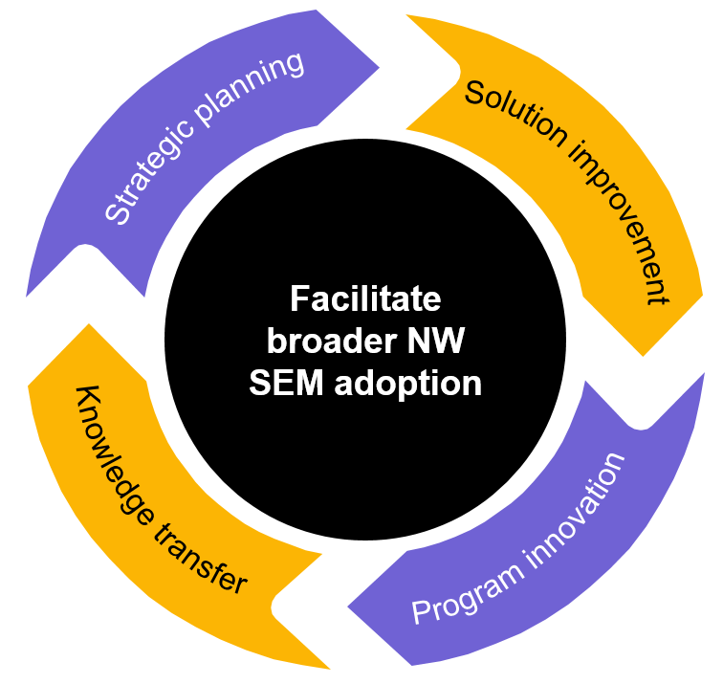
M&V Group Focus to Date
Knowledge Sharing and Solutions Improvement
2013 - 2014
Autocorrelation & Multicollinearity
2014 - 2015
Common Challenges in Industrial Baselines
2016 - 2018
Alternatives to Forecasting Models
Notes:
We’ve come a long ways. Modeling methods have been tested and documented (ESI MT&R, SEP 2017, CA Guidelines, etc.)
Now we are seeing a need for establishing how these multi-year programs quantify savings in the out-years whether reenrolled, no longer enrolled, or after experiencing changes that may invalidate exisitng models.

Slide 15
Potential Topics for 2018-19
2018-19 Work Plan
Topics from Open Space
Address Findings from IEPEC Papers
Publish Alternate M&V Method Guide
Analysis on Simulated Data Sets
Estimating Confidence Intervals
Measure Life
Continuation Programs
Notes:
A wide range of topics were presented to the M&V subgroup which kicked off on May 31, 2018.
Chad Gilless and Steve Martin passed leadership to Tina Schnell and Sara York.
(other topics people would like to address?)

Slide 16
M&V Group Goals
Be a community that shares and discusses measurement and verification complexities and best practices.
Identify, create and publish guiding deliverables that
simplify, standardize, and explain
SEM measurement and verification challenges.
Notes:
The M&V Group identified these goals for 2018

Slide 17
The Region’s SEM M&V Support Group
Measure Life
Jacob Schroeder (Cascade)
Jennifer Huckett (Cadmus)
Kati Harper (Energy Trust)
Robert Greenwald (Prism Engineering)
Sara York (Cascade)
Steve Martin (Cascade)
Tina Schnell (AESC)
Todd Amundson (BPA)
Alex Novie (Energy Trust)
Kevin Campbell (Energy 350)
Mary Hinkle (CLEAResult)
Ross Lancaster (SEG)
Bill Miller (LBNL)
Chellie Jensen (Idaho Power)
Heidi Javanbakht (Cadmus)
Jennifer Huckett (Cadmus)
Jim Stewart (Cadmus)
Julia Vetromile (ret. DNV GL.)
Nick Leritz (NEEA)
Peter Therkelsen (LBNL)
Richard Milward (Richard S. Milward)
Ross Lancaster (SEG)
Sam Day (CLEAResult)
Alternative Methods to Forecasting
Continuation Programs:
When and how to rebaseline/remodel
Notes:
Animation. Click to reveal the teammember names under each group. Group leaders are in bold.
The group elected to break into teams to discuss and determine what we could do to advance these topics.
Next slide: Pass off to Sara for paper review

Slide 18
Phase I (2016): Documentation of Alternative Methods
Alternative M&V Method Workbook
Simplified Forecasting
Bayesian Gaussian
Chaining
Backcasting
Mean Model
Pre-Post
Key Performance Indicator - Bin Approach
Notes:
Brainstorming of potential alternatives to fully-specified forecasting regressions
As we worked through paper and reviewed new resources (SEP 2017, CA Guidelines), we realized a few things.
1st – many methods have the same criteria and statistics, meaning they could be pulled to a summary section.
2nd – with the recent publications, a strong value for the paper would be method selection guidance.

Slide 19
Method Selection Guidance
Three Key Questions:
Is model developed pre- or post-savings period?
Can predictor variables (energy drivers) be identified?
Is total savings sufficient or is more granular information needed?
Notes:
Finally, as we worked through and fine-tuned sections, it became apparent that some methods are actually analytical options applicable to most or all methods.

Slide 20
Phase II (2018): Documentation of Methods
M&V Method Workbook
Fore-casting
Back-casting
Pre-Post
Mean Model
Chaining
Bottom-Up Analysis
Standard Condition
Analytical Options:
Variable Selection
  Reduced Form
  Fully-Specified
Analysis
  Least-squares regression
  Bayessian-Gaussian
Performance Insights
Key Performance Indicators
  Single
  Bin Approach
Notes:
Variable selection – reduced form or fully-specified could be applied to any regression model.
KPI models are essentially very reduced form forecasting models with the additional complexity of maintaining multiple models. KPIs are extremely useful tools to evaluate energy savings and systems performance.
Call for reviews – Likely early November
Hand to Julia

Slide 21
SEM Measure Life
M&V Subgroup
Julia Vetromile

Slide 22
SEM Measure Life M&V Subgroup
Provide a framework
Focus on Industrial
Predicting the EUL for a new program
Determining the EUL of on-going programs

Slide 23
Predicting the EUL
Bottom-up
Borrow
Mid-course corrections
Look at potential from existing EEMs
Predict program participation and measures
Literature review, current studies
Shared program data

Slide 24
Estimating the EUL
Verify actions taken
Assess EULs from secondary sources or EUL studies
Challenge: Effect of participant commitment on EUL

Slide 25
SEM Continuation Programs Subgroup
Kevin Campbell

Slide 26
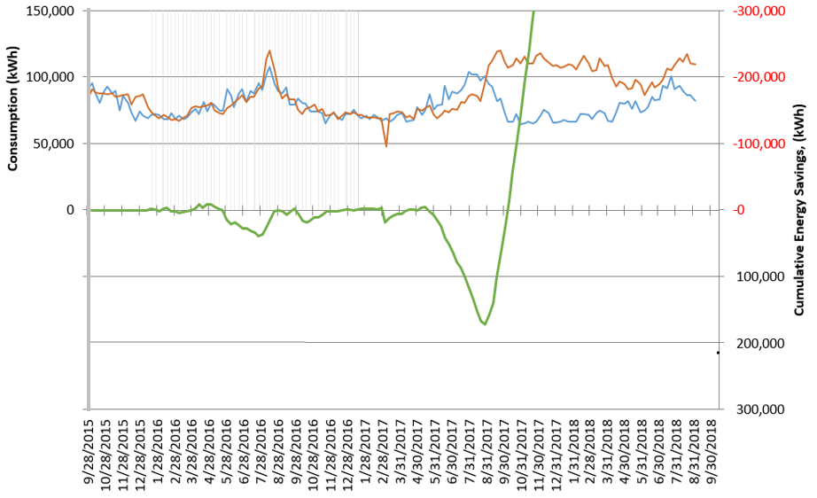
Continuation Programs Subgroup
Time →
Actual Energy Use, Predicted Energy Use, CUSUM
Notes:
Objective: Understand M&V challenges for sites in SEM for multiple years
Contributing Members: Kevin Campbell, Mary Hinkle, Ross Lancaster, Tina Schnell, Todd Amundson
Progress: Draft re-baselining decision tree and spreadsheet tracking how utilities handle M&V for continuation programs.

Slide 27
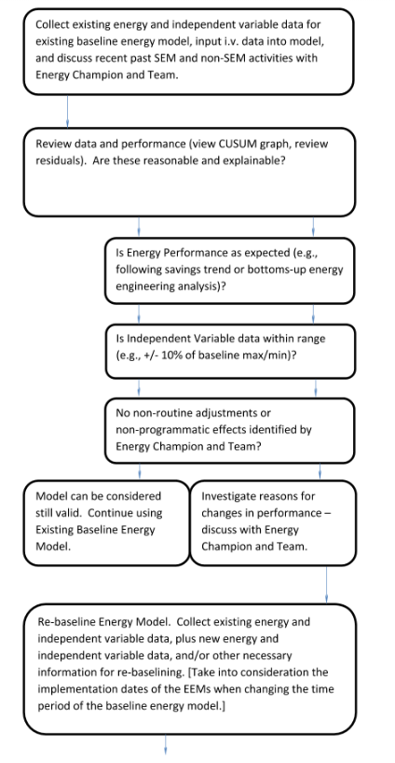
Draft Re-baselining Decision Tree

Slide 28
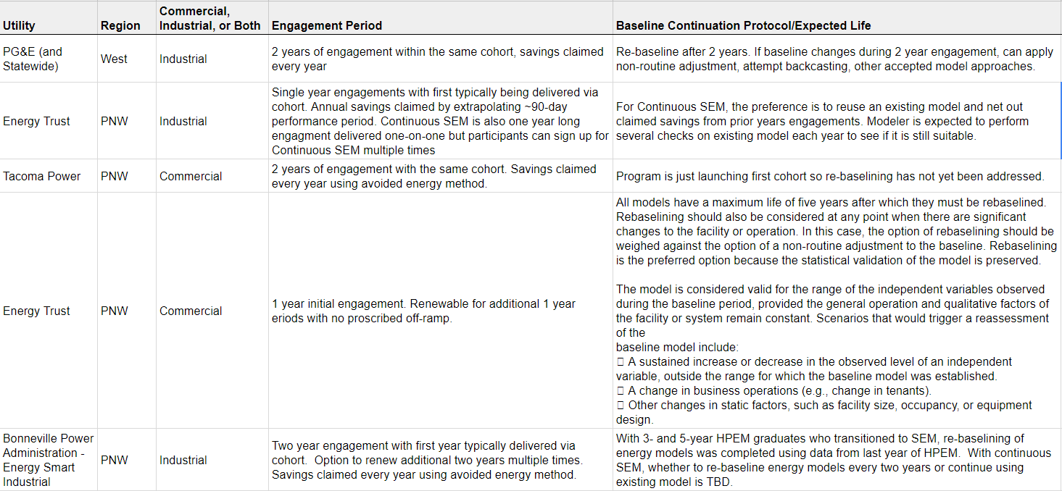
Draft Cont Program Utility Tracking

Slide 29
Certification & Recognition
Work Group
Jessica Raker, Puget Sound Energy

Slide 30
Benchmarking
Work Group
Kevin Wallace, BC Hydro

Slide 31
Vision
There exists a database of Energy Management Assessment data that enables analysis of SEM practice adoption trends across SEM program participants of the NW SEM Collaborative to provide program and market insights to drive program innovation and increase results.

Slide 32
Objectives
Common Data Format
Benchmarking
SEM Collaborative Strategy
Notes:
Common Data Format - utilize the NEEA online SEM Hub EMA tool to capture/collect EMA data from individual SEM programs participants in a common format to enable benchmarking.
Benchmarking – undertake analysis of the data set to provide market insights, learning, about individual participants and/or understand differences between programs and market adoption.
SEM Collaborative Strategy – enable the NW SEM Collaborative to set longer term quantitative targets around improving SEM practices and/or market transformation.

Slide 33
Benefits
Design Improvement
Compare Market Segments
Energy Savings
Notes:
SEM practice and design improvement – information that is gleaned from the data, could be used for program improvement, identification of best practices, recruitment, development of enhanced program criteria and new tools; could highlight differences between imbedded EM programs and Cohorts.
Compare Market Segments – will allow for comparison across and within commercial and industrial segments to identify best practices or market gaps.
Energy Savings – opportunity to correlate/link EMA score to energy savings; this is a secondary benefit/goal. BCH is using the EMA score as a screen for claiming SEM savings, but not prescriptively.

Slide 34
Data
Company | Program | # EMA Sessions
BC Hydro | SEM Industrial Energy Manager | 35
BC Hydro | SEM Industrial Cohort | ~ 12
BC Hydro | SEM Industrial Cohort 2 | 10
BPA | Energy Smart Industrial | 12
ETO | Commercial SEM – Pre NEEA EMA | 30
ETO | Commercial SEM – Pre 2018 | 56
ETO | Commercial SEM – 2018 | 19
ETO | Industrial SEM Programs | ?
PSE | Energy Smart Bellevue | 8
Misc. | SEM Hub EMA Users | 11
Misc. | Anonymous Industrial User | 76

Slide 35
Next Steps
Convert the data – ongoing
Provide data to NEEA – ongoing
Develop a draft analysis framework
Resource to undertake analysis
Notes:
1. Complete the table to understand what data is potentially available. – Done!
2. If not in the NEEA online EMA common format, convert the data. – Done and ongoing!
3. Provide the data to NEEA who will compile and host in one aggregated data set. – Done and ongoing!
4. Develop a draft framework for the data analysis. Next!
5. Identify a resource to undertake the analysis and provide results.

Slide 36

“Beyond the E” Workgroup
Northwest SEM Collaborative

Slide 37
“Beyond the E” Workgroup 2018 ACTION
Tips and Tricks: Succession Planning
Tips and Tricks: Building a Cross-functional Energy Team
Tips and Tricks: Successful Executive Engagement
Kathleen Belkhayat
Karen Brooks Debbie Driscoll
Thu Tran Patrick Urain
Kati Harper Robert Hemphill
Romana Cohen Jessica Raker
Mike Christianson Tashina Jirikovic
Greg Lehoux Julie Hayes
Mikki Lee Steven Scott Wendy Gibson Warren Fish
Todd Amundson Kim Crossman

Slide 38
Program Design for Successful Executive Engagement: BEFORE
RECRUIT at the right level
Coaches and program managers build relationship with Executive sponsor ahead of time; understand MOTIVATIONS
REQUIRE:
  Active role of sponsor in visibly approving policy/signatory/disseminating information
  Energy champion/ ES 1:1 time
Verbal discussion of written roles during kickoff or first meeting
ATTENDANCE: Required and encouraged to attend first and last workshop, some energy team meetings

Slide 39
Program Design for Successful Executive Engagement: DURING
Requirements written into role/JOB DESCRIPTION
TEACH energy champion to celebrate success and include Executive Sponsor in communications and events
Utilize ENERGY PITCH
Communication strategies built to emphasize MOTIVATIONS

Slide 40
Program Design for Successful Executive Engagement: AFTER
Provide good PR opportunities
LIGHT TOUCH communication with Executive sponsor, especially for references, re-enrollment, and evaluation

Slide 41


BREAK
n o r t h w e s t

Slide 42
WHAT’S HOT:
HOW POLICY & SEM MIGHT MEET IN THE MIDDLE
Panel Leader: Jim Stewart, Cadmus Group
Local Policy Danny Grady, City Of Portland Rebecca Baker, City of Seattle |  | International Policy (ISO 50001) Kevin Wallace, BC Hydro Chad Gilless, Stillwater Energy
n o r t h w e s t

Slide 43

NW SEM Collaborative
What’s Hot Panel
REBECCA BAKER
Benchmarking and Tune-Ups Program Manager
October 25th, 2018

Slide 44
Energy Efficiency in the Era of Mandates
  Seattle’s energy efficiency building regulation
    Building Tune-Ups SMC 22.930
  Builds on energy benchmarking program
    SMC 22.920
  Companion grant program
    Building Tune-Up Accelerator
  Evolving role for Utilities
    Companion incentives & alternative compliance

Slide 45

What is the Seattle Building
Tune-Ups Program?
Notes:
The mandate was adopted in March of 2016, after 1 ½ years of public engagement.
Applies to a subset of non-residential buildings that benchmark – those 50,000 sq.ft. or larger
The intent is to achieve energy and water savings and GHG emission reductions by ensuring that buildings are operated to their full potential.

Slide 46

What does a Building Tune-Up Entail?
  Identify operational and maintenance improvements
  Includes building assessment & implementation of required fixes
  Requires recommended voluntary fixes
  Typically generate 10-15% energy savings
  Based on PNNL’s Building Re-tuningTM Program
Notes:
The focus in on operational and maintenance improvements – on improving the operation of existing equipment – not investing in capital upgrades (such as retrofits or replacements of equipment)
We talk about a Tune-Up as “retro-commissioning lite” and the average energy savings range from 10-15%
More detail:
“Larger, more expensive energy-saving measures that require capital investment, are not implemented as part of retuning.”
NOT included in mandate
Audits
Capital investments
Lighting upgrades
Commissioning
EUI or ENERGY STAR Targets

Slide 47
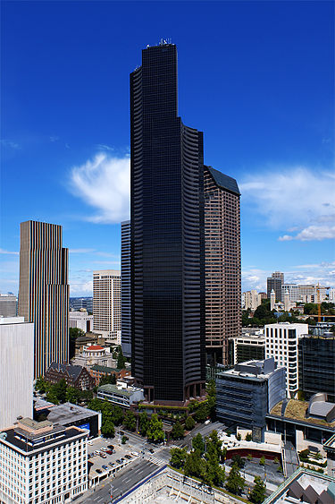
Who Needs to Comply?
  All commercial buildings and spaces 50,000 sf or greater (excluding parking)
  Tune-Up required every five years
  City leads by example
  All municipally owned buildings must meet
  deadlines one year ahead of private sector

Slide 48










Compliance Process
Identify compliance year
Find a Tune-Up
Specialist
Tune-Up your
building
Report
to the City
DATE
PATHWAY
SPECIALIST
TUNE-UP
REPORT
Pursue alternative compliance
Demonstrate Tune-Up equivalency or high performance
Participate in Accelerator Program (<100K sf)

Slide 49

Alternative Compliance

Slide 50


Alternative Compliance Pathways
High Performance | Certified ENERGY STAR Score (90 – buildings 100k+, 85 – buildings < 100k LEED O+M Gold or Platinum (with 17 EA credits) Living Building, Petal, or Net Zero Energy (with Net Positive Energy Imperative) Low Energy Consumption (EUI 20 or lower)
Equivalent Process | Ongoing Commissioning (OCx) (all systems monitored 2 years prior) Completed Retro-commissioning (RCx) ASHRAE Level 2 Audit + Implemented Recs Reduced EUI (15% for buildings with WN EUI < Seattle Median) New Construction or Substantial Alteration
Tune-Up Accelerator | Incentives for buildings 100K SF or less

Slide 51
Under Limited Circumstances
Single-Round Waiver | Demolition Major Renovation Financial Distress
Extension Requests | Change of Ownership High Vacancy Rate Existing Mechanical Improvements Demonstrated 15% EUI Reduction

Slide 52


Tune-Up Specialist Qualifications
DATE
PATHWAY
TUNE-UP
REPORT
At least seven years experience plus one of the following:
Professional Engineer PE
Building Operator Certification BOC Level II
Certified Energy Manager CEM
Certified Commissioning Professional CCP
Commissioning Authority CxA
Existing Building Commissioning Professional EBCP
Bachelor in Sustainable Building Science Technology BAS

Slide 53
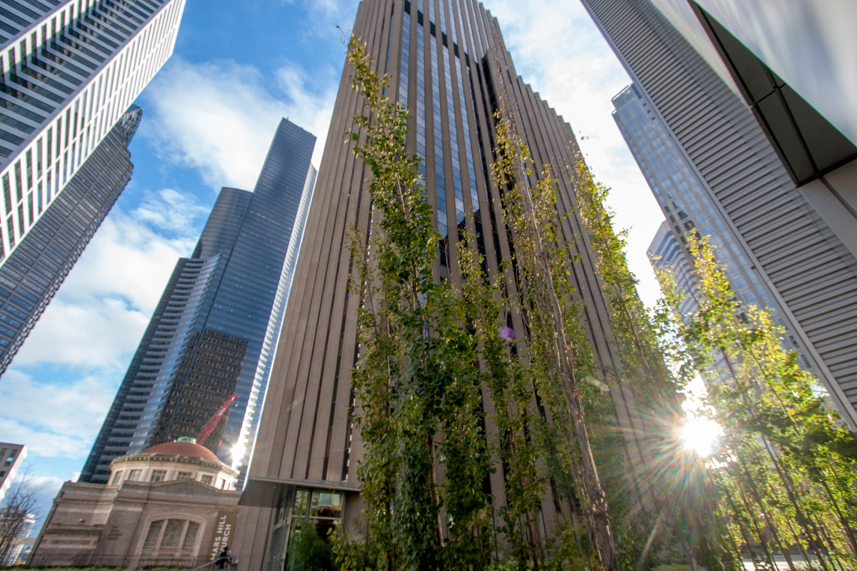
What is the Tune-Up Accelerator?

Slide 54

Tune-Up Accelerator Program
<100,000 SF / Due 2020 or 2021
Tune-up now to meet Seattle Building Tune-Ups requirements
Financial incentives & enhanced technical support - sunsets after 2018
2017
Q2 2019
Notes:
ACCELERATOR
Tune-Up Accelerator program is a pilot program working with buildings 50,000-100,000 SF to jumpstart tune-ups.
The Accelerator benefits include enhanced technical support and financial incentives to conduct a tune-up that meets the mandate.
DOE-Funding Partnership among Seattle OSE, Smart Buildings Center, Seattle City Light, University of WA Integrated Design Lab and Pacific Northwest National Lab.

Slide 55
Program Incentives
City Light incentive of up to $0.12 per SF for tune-up that meets requirements
Plus incentives for energy-saving improvements like lighting, HVAC
Support for deeper investments like renovations or tenant improvements
A. BASIC TUNE-UP
B. TUNE-UP PLUS
C. BUILDING RENEWAL
2017
Q2 2019
Notes:
ACCELERATOR
Tune-Up Accelerator program is a pilot program working with buildings 50,000-100,000 SF to jumpstart tune-ups.
The Accelerator benefits include enhanced technical support and financial incentives to help comply with the mandate.
Different incentives and levels of support.
Basic Tune-Up - Incentives to meet mandate. $0.12 ($0.03 for Assessment and $0.09 for corrective actions, up to 70% of costs).
Tune-Up Plus – Meet mandate and add capital ECMs
Building Renewal – Technical support and engineering analysis for deeper retrofits

Slide 56

ISO 50001 Country Survey
Monday, October 22, 2018

Slide 57
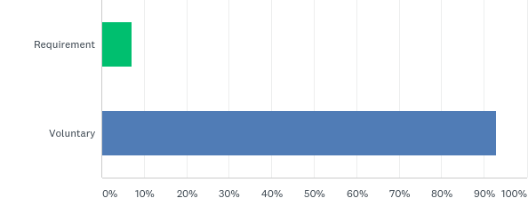
Q4: What is your country's policy position on ISO 50001?

Slide 58

Notes:
Tax refunds for large users. So, is it required? Or just heavily subsidized?

Slide 59

Notes:
UK - can be used for compliance under Energy Savings Opportunity Scheme

Slide 60
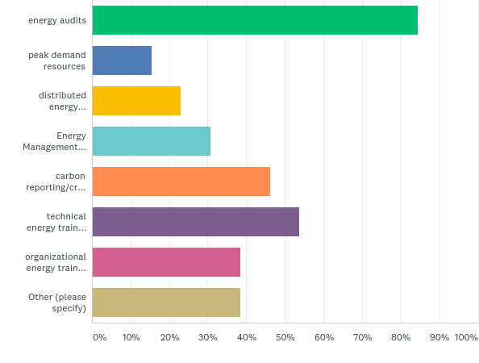
Q8: Are there other energy management programs/tools that support (or integrate with) ISO 50001 adoptions and regulation?

Slide 61






Notes:
Ireland - Certification to the standard can be used as one of the approaches of a large organization to meet the requirements of Article 8 of the energy efficiency directive (undertaking an audit every 4 years for organizations that are deemed to be a large undertaking (not an SME)).
South Africa - Large energy consumers need to submit mandatory energy management plans to the SA DoE. These plans should be aligned to ISO.
Japan - ISO50001 share the common contents of domestic regulations which encourage energy savings. The current energy conservation law in Japan indirectly supports implementation of EnMS which has been stipulated by ISO50001.
Argentina - In 2017 the Ministry of Energy together with the Ministry of Production published a voluntary resolution (for some types of industries) to access energy subsidies if they initiate an energy review process.
Mexico - 3.5.4 Energy Use – application of energy. In Mexico, there are 32 regulations about energy efficiency for example: Ventilation, lighting, transportation and electric motors.
Canada – GHG regulations and Carbon pricing schemes

Slide 62



Notes:
Chile – Now is voluntary, but there are an Energy Efficiency Law Project, being discussed in the Chilean Parliament. This initiative promote ISO 50001 for the most energy intense consummers along the country, but it does not seek to force but rather to encourage .
Tunisia - Our Country's policy is voluntary but we have in store a programme to grant fund all organizations want to implement ISO 50001
Morocco - still draft regulation. Compliance with ISO 50001 can be used to show compliance to the requirement in terms of energy efficiency.

Slide 63
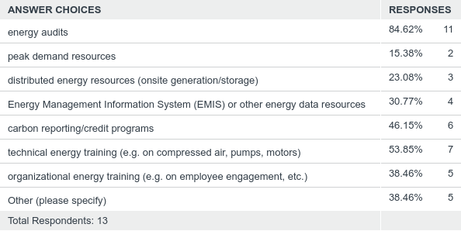
Q8: Are there other energy management programs/tools that support (or integrate with) ISO 50001 adoptions and regulation?

Slide 64
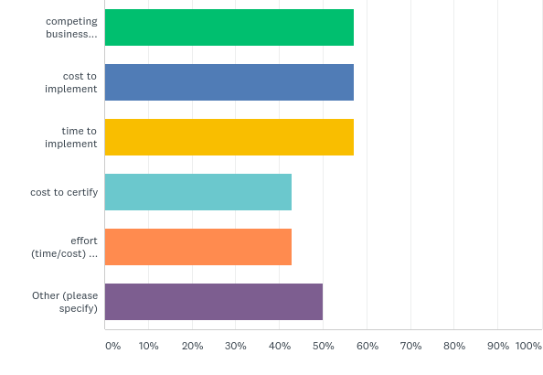
Q10: What are your country’s biggest challenges with ISO 50001 adoption?

Slide 65
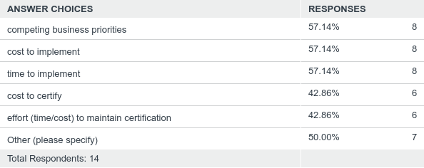
Q10: What are your country’s biggest challenges with ISO 50001 adoption?
Answered: 14 Skipped: 0

Slide 66
ISO Certifications Worldwide

Slide 67


Slide 68
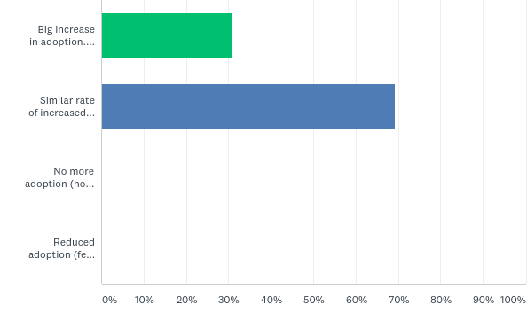
Q12: Do you foresee a change in the rate of ISO adoption in your country?
Answered: 13 Skipped: 1
Notes:
4/13

Slide 69
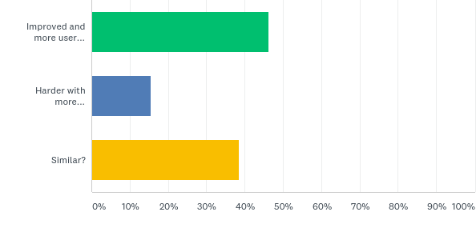
Q13: Do you see the new release of ISO 50001:2018 as:
Notes:
6/2/5

Slide 70
50000 Family
50002
50003
50004
50006
50008
50015
50021
50046
50005
50007
50009
50044
Ad Hoc ZNE

Slide 71




Slide 72

LUNCH

Slide 73
NW Power Plan &
Strategic Energy Management
NW SEM Collaborative Keynote Presentation
Charlie Grist, Northwest Power & Conservation Council

Slide 74
NW Power Plan and Strategic Energy Management
SEM Collaborative October 2018

Slide 75
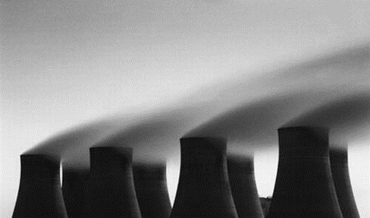
Outline:
The PNW Power System
The Value Proposition: Efficiency as a Power Resource
Attributes of Strategic Energy Management
Challenges and Opportunities for SEM
Notes:
Photo Radcliffe Power Station, Nottinghamsire, England 2000 MW coal

Slide 76
Ode to Electricity
Notes:
Civilization hangs perilously
On slender threads of electricity

Slide 77
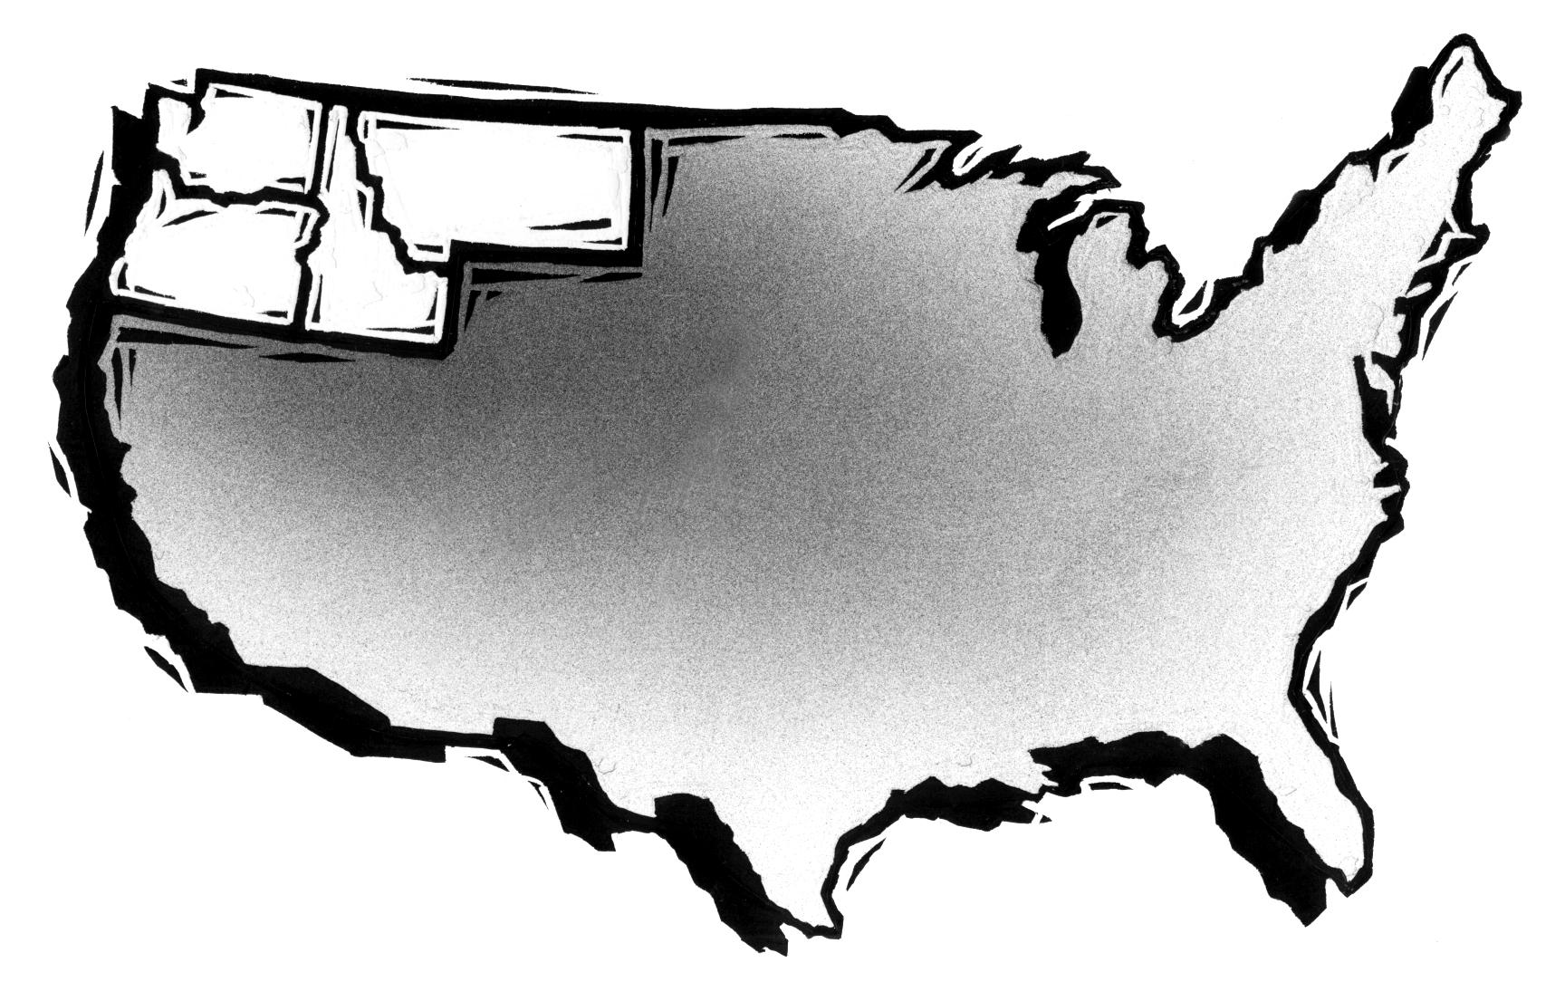

Pacific Northwest Region
The 1980 Regional Power Act
Notes:
In 1980, the Regional Power Act drew the region together for power planning and fish and wildlife enhancement and recovery on the Columbia River.
In simple terms, the Council was created, by Congress, to give the people of the region a voice in the development of power and fish resources of the Columbia River.
Of course Congress does not go around willy-nilly giving the people a voice
Two big mess up. 1) over-committed to building new thermal generation, bond default, 2x ws rates. 2) We nearly wiped out salmon and steelhead runs in the massive Columbia River Basin.
So Congress set up the Northwest Power and Conservation Council to do regional power planning and fish & wildlife recovery.
Every five years the Council does a regional power plan
Today’s talk springs from the making of the 7thPower Plan.
It’s the longest running electric IRP in the country. It’s had a run that surpasses the record of the Broadway musical ‘Cats’, which also debuted in 1981.
Scope is Regional (NO Gas).
Impact on ETO: Commissions & utilities pay attention to it for resource development recommendations: cons & generation

Slide 78
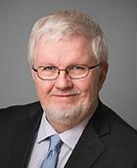




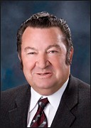
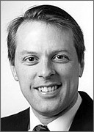
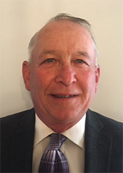
Northwest Power and Conservation Council
An interstate compact
Eight members, two from each state
Headquarters in Portland
Staff of 65; Budget of $9.5 million
Funded by BPA, but not part of BPA
Notes:
The Northwest Power Act also allowed for the creation of the Northwest Power and Conservation Council and gave the council three specific tasks:

Slide 79

Two Big Columbia River Mess-Ups Created the Council
Power Planning Mistakes
  Terminate or mothball:
  9 planned nuclear plants
  5 planned coal plants
  $7 billion wasted**
Fish & Wildlife:
  Dams block fish passage
  Habitat degradation
**The financial bailout initiates Northwest Power Planning and Conservation Act of 1980

Slide 80
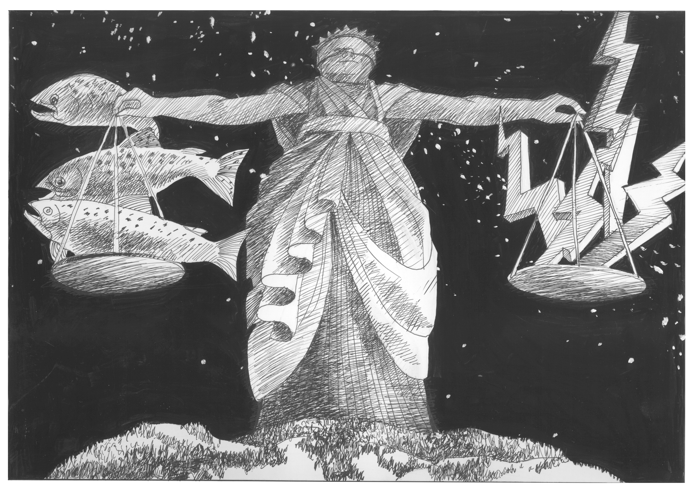
The Tenants 1980 Regional Act
Adequate, Efficient, Reliable Power System
  Least-Cost – considering all costs & environment
  Conservation considered a resource (10% advantage)
Protect, mitigate & enhance fish & wildlife
  Affected by hydro in the Columbia River Basin
Open Public Process
  Giving the people a voice
Notes:
Resource priorities in the Act (23 years before California loading order)
Conservation
Renewable Resources;
Generating resources utilizing waste heat or generating resources of high fuel conversion efficiency
All other resources.

Slide 81
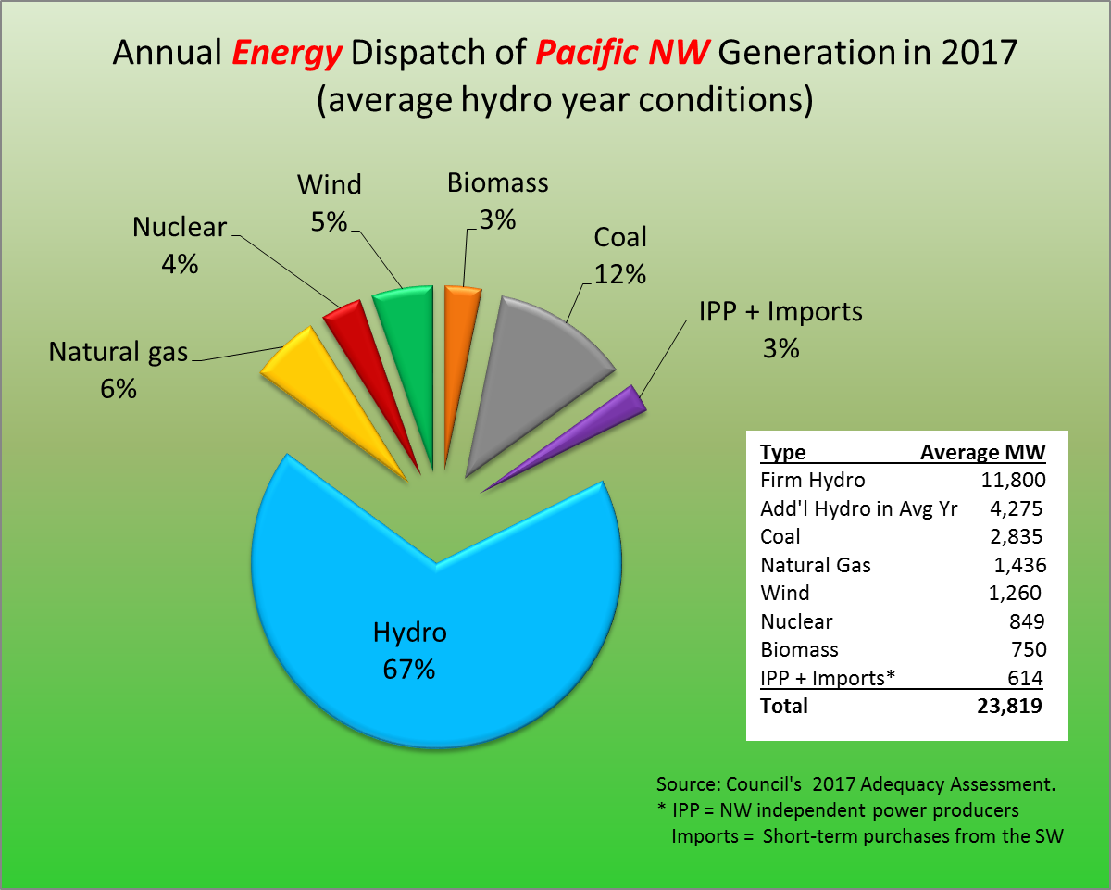
PNW Power System
PNW Energy Production
(Average Hydro & Wind)
PNW Loads
28,000 MW Summer Peak Hot Year
36,000 MW Winter Peak Cold Winter
20,000 aMW Energy
$14 Billion Annual Bill

Slide 82
Energy Efficiency
Second Largest Resource After Hydro
Twice Size of Coal

Slide 83
Industrial Energy Productivity Improves:
Both:
1) Efficiency
2) Shift to Less Intensive Industrial Base

Slide 84

The Resource Planner’s Problem
Don’t have too many resources
Don’t have too few resources
Have “just the right amount” of resources*
*Resources include energy, capacity, flexibility & other ancillary services needed for system reliability.
Resource Cost and Risk Profile are the big drivers

Slide 85
Forecast Load Growth Over The Next Two Decades
(Average Over 800 Futures)
Notes:
All going up:
Population
Households
Employment
Commercial Floor space
Industrial Output
Plus scheduled closure of six coal plants – so resource deficit emerging

Slide 86
All Resource Cost – Energy
Characteristics
Cost Energy
Cost Capacity
Flexibility
Planner Dilemma
How Much?
When?
What Risk?
Ave EE
Notes:
We look at all costs of all resources
This is Energy cost
Also look at Capacity Cost
Resource flexibility and ramping
And the uncertainty in costs
Which for fossil fuel resources can have a wide band around it.
For example cost of fuel on the CCCT can range from $30 to $90 /MWh depending on gas price and whether or not carbon costs included

Slide 87
Seventh Power Plan Least Cost Resource Strategies for Meeting Forecast Energy and Capacity Needs
About 7% from SEM
Notes:
Key Finding: Energy Efficiency and Demand Response can meet nearly all growth in energy and capacity needs through 2035
About One-Third of the EE is from more efficient lighting (at technology and prices ~2017)

Slide 88
Forecast Load Growth Over The Next Two Decades
(Average Over 800 Futures)
Notes:
All going up:
Population
Households
Employment
Commercial Floor space
Industrial Output
Plus scheduled closure of six coal plants – so resource deficit emerging

Slide 89

SEM in Power Plans
Plan released 2010
SEM debut – huge potential
Based in Envinta One to Five & strong case studies
Regional skepticism
“It’s soft”
“Management is not a measure”
“We have no idea how to do this as a program”
Some key players were swayed
Program emergence: SEM, HPEM, Energy Managers

Slide 90

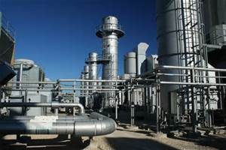
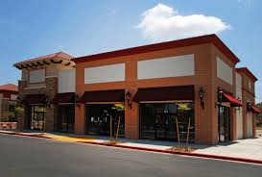
Seventh Power Plan:
Industrial AND Commercial Energy Management Potential

Slide 91
7P EE by Sector
Cost-Effective Energy Efficiency Potential (aMW)
Sector | 2021 | 2026 | 2035
Agriculture | 60 | 89 | 117
Commercial | 554 | 1,242 | 1,762
Industrial | 284 | 485 | 571
Residential | 530 | 1,104 | 1,735
Utility | 28 | 77 | 187
Grand Total | 1,457 | 2,998 | 4,371
Notes:
Overall goals/targets
Sector makeup of these goals ()

Slide 92

Commercial Measures
Cost-Effective Potential (aMW)
End-Use and Measure | 2021 | 2026 | 2035
Compressed Air | 5 | 9 | 17
Compressed Air | 5 | 9 | 17
Electronics | 104 | 314 | 392
Data Centers | 55 | 230 | 261
Desktop | 13 | 28 | 56
Laptop | 0 | 1 | 4
Monitor | 6 | 12 | 24
Smart Plug Power Strips | 30 | 42 | 47
Food Preparation | 6 | 23 | 64
Cooking Equipment | 6 | 23 | 63
Pre-Rinse Spray Valve | 1 | 1 | 1
HVAC | 130 | 284 | 407
Advanced Rooftop Controller | 22 | 83 | 117
Commercial EM | 41 | 59 | 65
DCV Parking Garage | 8 | 12 | 13
DCV Restaurant Hood | 6 | 8 | 8
Demand Control Ventilation | 12 | 17 | 18
DHP | 12 | 43 | 60
Economizer | 18 | 26 | 26
Premium Fume Hood | 0 | 1 | 4
Secondary Glazing Systems | 1 | 5 | 10
VRF | 5 | 25 | 78
WEPT | 3 | 7 | 7
End-Use and Measure | 2021 | 2026 | 2035
Lighting | 240 | 483 | 721
Bi-Level Stairwell Lighting | 1 | 4 | 9
Exterior Building Lighting | 59 | 126 | 142
LEC Exit Sign | 4 | 9 | 19
Lighting Controls Interior | 2 | 6 | 13
Low Power LF Lamps | 14 | 39 | 39
LPD Package | 123 | 234 | 428
Parking Lighting | 6 | 8 | 8
Street and Roadway Lighting | 30 | 57 | 61
Motors/Drives | 6 | 17 | 35
ECM-VAV | 4 | 12 | 30
MotorsRewind | 2 | 4 | 5
Process Loads | 19 | 42 | 47
Municipal Sewage Treatment | 14 | 32 | 35
Municipal Water Supply | 5 | 11 | 12
Refrigeration | 39 | 63 | 70
Grocery Refrigeration Bundle | 37 | 52 | 57
Water Cooler Controls | 2 | 11 | 13
Water Heating | 4 | 6 | 10
Showerheads | 3 | 4 | 4
Washer | 0 | 2 | 4
WHTanks | 0 | 1 | 2
About 4% of Commercial Potential
Total | 554.1 | 1242 | 1762

Slide 93
Commercial Energy Management
Suite of measures, mostly HVAC system controls
Replaces 6P HVAC Commissioning and Controls
Assumptions:
  Savings based on program findings
  For retrofit, savings range 1.0 to 2.2 kWh/sf plus gas
  For new, savings range 0.5 to 1.2 kWh/sf plus gas
  Exclude single zone ducted systems
  Lifetime 5 years (down)

Slide 94
Seventh Plan Industrial Potential*
*Total Technical Potential = 661 aMW
Plant Energy Management
Integrated Plant Energy Management
Energy Project Management
Notes:
Lost some pulp and paper production

Slide 95
What’s in “Energy Management”?
Energy Management | Total | 320 (aMW)
Air Compressor Optimization |  | 9
Clean Room: Chiller Optimize |  | 1
Cold Storage Tuneup |  | 3
Energy Project Management |  | 87
Fan Energy Management |  | 8
Fan System Optimization |  | 25
Food: Refrig Storage Tuneup |  | 7
Fruit Storage Tuneup |  | 12
Groc Dist Tuneup |  | 1
Integrated Plant Energy Management |  | 77
Plant Energy Management |  | 41
Pump Energy Management |  | 13
Pump System Optimization |  | 35

Slide 96
Whole Plant Measure Tiers
Plant Energy Management (Good)
  Includes low/no cost energy efficiency projects for multiple systems
  Maintenance and operations
Energy Project Management (Better)
  Based on a package of optimized equipment improvements and includes the assignment of an energy engineer
Integrated Plant Energy Management (Best)
  Includes a comprehensive plant management program including development and implementation of an energy management plan (policy, accountabilities, goals, department/system level targets and measurements, etc.) to support sustainable improvement of energy intensity and productivity
  Independent verification of energy savings.
Applicable All Ind
Shallow Savings
Applicable Some Ind
Higher Savings
Applicable Some Ind
Deep Savings
Notes:
Level one applies to all industries except cold storage
Levels 2 and 3 apply only to: Pulp & paper and Food Processing
Remaining available 50 to 75%
Where applicable:
Applies to about 27% of load
Shallow savings about 12%
Moderate savings about 29%
Deep savings 50%
T1 T2 T3 are interactive
Inventory factor from other measures reduces potential

Slide 97
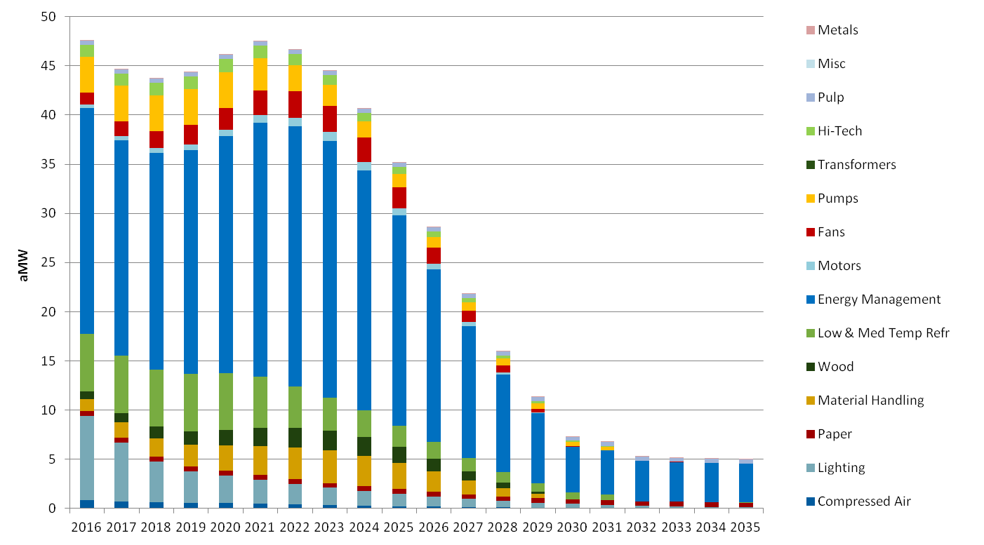
7P Annual Incremental Savings Potential
(Industrial, Cost-Effective, by End-Use)
Three-Tier SEM

Slide 98
So What Is Actually Happening?

Slide 99
Approach for Plan 8
Develop savings estimates in 2019
Updating industrial load forecast & conservation
Industry by industry approach
  18 industrial segments –major plants plus extrapolation
  Using industry experts and third-party
  Develop plant-specific data; E per unit product, E per employee
  EE program data provides some insight to remaining savings
Need better intel on saturation of measures, incl SEM

Slide 100

Assess remaining SEM potential
  Cost & savings
  How deep is the well? – What’s left?
  Coordinated data collection and analysis via NEEA tool?
Longevity and Durability issues
  EE as a resource must be durable – or at least predictable
  Measure life, persistence studies, decay estimates
Scale
  Penetration to smaller Ind sites? Penetration commercial (MUSH?)
  How fast can uptake happen?
  Role outside motivation; ISO 50001, carbon accounting, supply chain requirements

Slide 101

Emerging Power System Trends & Issues
Flat to low load growth
Resource retirements growing – coal mostly
Surplus renewables – low market prices for electricity
Natural gas price forecasts continue to decline
Capacity needs emerging as dominant driver expansion
Cost of natural gas peakers down
Demand Response gaining traction
Cost declines & system impacts of solar & wind
Carbon constrained future
Business model for electric utilities
Challenges
and Opportunities
for EE Relative to the Past

Slide 102
What Does This Mean for SEM?
Paradigm: Efficiency as a power resource
  Low Cost EE Good – High Cost EE Marginal
  Value the Capacity Impacts of SEM

Slide 103
End

Slide 104
Total Energy Use Per Capita Falling

Slide 105
All Sectors Less Electric Intensive
Per Capita

Slide 106
Total Energy Consumption per Economic Output Down Over 50%

Slide 107
Electricity per $GSP is Half of 1990 Level

Slide 108
Industrial Energy Productivity Improves:
Both:
1) Efficiency
2) Shift to Less Intensive Industrial Base

Slide 109
Industrial Measure & Practices
Air Compressor Demand Reduction
Air Compressor Equipment
Air Compressor Management
HighBay Lighting
Lighting Controls
Motors: Efficient Rewind VSD Controls
Motor Management Program
Fan Efficient Centrifugal
Food: Fans and Blowers
Other: Fans and Blowers
Fan ASD Control
Premium Pump
Pump ASD Control
Food: Cooling and Storage
Food: Refrig Storage O&M
Metal: New Arc Furnace
Paper: Medium Consistency Pump
Mech Pulp: Refiner Replacement
Mech Pulp: Premium Process
Mech Pulp: Refiner Plate Improvement
Kraft Pulp: Effluent Treatment System
Kraft Pulp: Efficient Agitator
Paper: Efficient Pulp Screen
Paper: Premium Fan
Paper: Material Handling
Wood: Replace Pneumatic Conveyor
Wood: Hydraulic Press
Cold Storage Retrofit
Cold Storage Tuneup
Fruit Storage Refer Retrofit
CS Retrofit -- CO2 Scrub
CS Retrofit -- Membrane
Fruit Storage Tuneup
Groc Dist Retrofit & Tuneup

Slide 110
Industrial Model Structure
Regional Industrial Loads
Mechanical Pulp:
4,260 GWh
Pumps (32%)
Fans (6%)
Frozen Food:
1,240 GWh
Other Segments….
Other End-Uses…
Measure: Pump energy management (% of end-use)
Measure: Pump equipment upgrade (% of end-use)
Measure: Pump System Optimization (% of end-use)
Loads by segment
(18 segs)
Share of end-use by segment
Measures that apply to each end-use
Continued on next slide

Slide 111
Industrial Model Structure (cont.)
Measure Savings:
Pump energy management
(% of end-use)
% Savings
Applicability (%)
Achievability (%)
Inventory Factor (%)
Example for Pump Energy Management in a Mechanical Pulp Facility
Mechanical Pulp 2035 MWh | 4,261,225
Pumps End-Use Share | 32%
% Savings for Pump Energy Management Measure | 8%
Measure Applicability | 30%
Achievability | 100%
Inventory Factor | 100%
Total Potential (MWh/yr) | 29,973

Slide 112
7P Industrial Potential
Total potential by 2035:
  Technical Potential = 661 aMW
  Achievable Potential = 555 aMW
  Cost-Effective Potential = 553 aMW
Almost all of the achievable potential identified is cost-effective
  Less than 6P, but still strong potential

Slide 113

Open Space
How can we continue to grow SEM in the Northwest and beyond?

Slide 114
OPEN SPACE
Process
Two discussion sessions – 45 minutes for each
Each group will use a Harvest Poster for discussion – need a scribe
In your discussion groups, you will brainstorm:
  What opportunities and challenges exist on this topic?
  How might they be addressed - what’s possible?
  Who cares about this? Who are the key stakeholders? (Collaborative, utilities, NEEA, other?)
  What are the leverage points?
  What are the next steps?
Capture key ideas to report out
Notes:
Role of the Host: To lead the conversation, keep it going, capture ideas
Participants offer up topics that are most relevant to them which they would like to engage in deeper discussion.
2 rounds, 30 minutes each, with 6 concurrent groups.
Group share-out and discussion (30 min).
Designed to transition into planning future work and direction of the collaborative.
Topics can be anything and might include: Persistence of Savings; Serving Smaller Customers; Pros & Cons of Funding an Embedded Energy Manager; Best Practices in Program Design and Implementation; SEM Benchmarking)

Slide 115
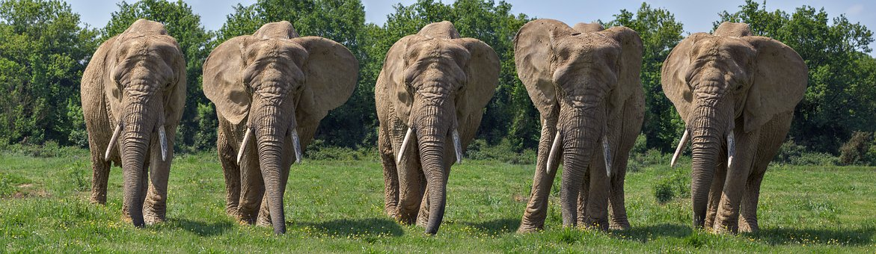
OPEN SPACE
Five Principles
1. Whoever comes are the right people.
2. Whenever it starts is the right time.
3. Whatever happens is the only thing that could have.
4. Wherever it is, is the right place – listen – space is opening everywhere all of the time.
5. When its over its over. For today anyway.
Notes:
Role of the Host: To lead the conversation, keep it going, capture ideas
Participants offer up topics that are most relevant to them which they would like to engage in deeper discussion.
2 rounds, 30 minutes each, with 6 concurrent groups.
Group share-out and discussion (30 min).
Designed to transition into planning future work and direction of the collaborative.
Topics can be anything and might include: Persistence of Savings; Serving Smaller Customers; Pros & Cons of Funding an Embedded Energy Manager; Best Practices in Program Design and Implementation; SEM Benchmarking)

Slide 116

OPEN SPACE
The Law of Two Feet
You are responsible for your schedule and participation. If at any time during our time together you find yourself in any situation where you are neither learning nor contributing, use your two feet, go someplace else.
Notes:
Role of the Host: To lead the conversation, keep it going, capture ideas
Participants offer up topics that are most relevant to them which they would like to engage in deeper discussion.
2 rounds, 30 minutes each, with 6 concurrent groups.
Group share-out and discussion (30 min).
Designed to transition into planning future work and direction of the collaborative.
Topics can be anything and might include: Persistence of Savings; Serving Smaller Customers; Pros & Cons of Funding an Embedded Energy Manager; Best Practices in Program Design and Implementation; SEM Benchmarking)

Slide 117

OPEN SPACE
Roles
LEADERS
Your role is to host the conversation.
This means arriving with an empty mind ready to listen to new ideas and questions.
PARTICIPANTS
Your role is to arrive with an empty mind and participate!
Listen openly and speak what’s on your mind. Help the conversation explore even deeper
BUTTERFLIES
You may choose to migrate between conversations.
Your role is to listen for connections between and across topics.
Cross-pollinate!
Notes:
Role of the Host: To lead the conversation, keep it going, capture ideas
Participants offer up topics that are most relevant to them which they would like to engage in deeper discussion.
2 rounds, 30 minutes each, with 6 concurrent groups.
Group share-out and discussion (30 min).
Designed to transition into planning future work and direction of the collaborative.
Topics can be anything and might include: Persistence of Savings; Serving Smaller Customers; Pros & Cons of Funding an Embedded Energy Manager; Best Practices in Program Design and Implementation; SEM Benchmarking)

Slide 118
OPEN SPACE
Session One
Savings persistence and measure life: finding agreement on how to measure it
A holistic regional SEM data plan: could automated data make our lives easier?
SEM tools: what additional resources could the NW SEM Collaborative develop?
What role should SEM play in helping states meet their climate and carbon goals?
Wild card 1: attendee generated topic
Notes:
Role of the Host: To lead the conversation, keep it going, capture ideas
Participants offer up topics that are most relevant to them which they would like to engage in deeper discussion.
2 rounds, 30 minutes each, with 6 concurrent groups.
Group share-out and discussion (30 min).
Designed to transition into planning future work and direction of the collaborative.
Topics can be anything and might include: Persistence of Savings; Serving Smaller Customers; Pros & Cons of Funding an Embedded Energy Manager; Best Practices in Program Design and Implementation; SEM Benchmarking)

Slide 119
OPEN SPACE
Session Two
Negative savings: how to banish them or at least deal with them
SEM as a wrapper: could it be an umbrella program for all C&I energy efficiency, DER and DR? How does SEM support IDSM and vice versa?
50001 Ready: which customer types are most ready for 50001 Ready, and can SEM programs help more customers earn that designation?
How should SEM programs adapt as machines get smarter in an increasingly connected world?
Wild card 2: attendee generated topic
Notes:
Role of the Host: To lead the conversation, keep it going, capture ideas
Participants offer up topics that are most relevant to them which they would like to engage in deeper discussion.
2 rounds, 30 minutes each, with 6 concurrent groups.
Group share-out and discussion (30 min).
Designed to transition into planning future work and direction of the collaborative.
Topics can be anything and might include: Persistence of Savings; Serving Smaller Customers; Pros & Cons of Funding an Embedded Energy Manager; Best Practices in Program Design and Implementation; SEM Benchmarking)

Slide 120

OPEN SPACE
Wild Card Slots
Identify question or topic you’re passionate about (you’ll be kicking off the discussion).
It should be something you are genuinely curious about, something for which you have more questions than answers.
Notes:
Role of the Host: To lead the conversation, keep it going, capture ideas
Participants offer up topics that are most relevant to them which they would like to engage in deeper discussion.
2 rounds, 30 minutes each, with 6 concurrent groups.
Group share-out and discussion (30 min).
Designed to transition into planning future work and direction of the collaborative.
Topics can be anything and might include: Persistence of Savings; Serving Smaller Customers; Pros & Cons of Funding an Embedded Energy Manager; Best Practices in Program Design and Implementation; SEM Benchmarking)

Slide 121
OPEN SPACE
Session One
Savings persistence and measure life: finding agreement on how to measure it
A holistic regional SEM data plan: could automated data make our lives easier?
SEM tools: what additional resources could the NW SEM Collaborative develop?
What role should SEM play in helping states meet their climate and carbon goals?
Wild card 1: attendee generated topic
Notes:
Role of the Host: To lead the conversation, keep it going, capture ideas
Participants offer up topics that are most relevant to them which they would like to engage in deeper discussion.
2 rounds, 30 minutes each, with 6 concurrent groups.
Group share-out and discussion (30 min).
Designed to transition into planning future work and direction of the collaborative.
Topics can be anything and might include: Persistence of Savings; Serving Smaller Customers; Pros & Cons of Funding an Embedded Energy Manager; Best Practices in Program Design and Implementation; SEM Benchmarking)

Slide 122
BREAK
n o r t h w e s t

Slide 123
OPEN SPACE
Session Two
Negative savings: how to banish them or at least deal with them
SEM as a wrapper: could it be an umbrella program for all C&I energy efficiency, DER and DR? How does SEM support IDSM and vice versa?
50001 Ready: which customer types are most ready for 50001 Ready, and can SEM programs help more customers earn that designation?
How should SEM programs adapt as machines get smarter in an increasingly connected world?
Wild card 2: attendee generated topic
Notes:
Role of the Host: To lead the conversation, keep it going, capture ideas
Participants offer up topics that are most relevant to them which they would like to engage in deeper discussion.
2 rounds, 30 minutes each, with 6 concurrent groups.
Group share-out and discussion (30 min).
Designed to transition into planning future work and direction of the collaborative.
Topics can be anything and might include: Persistence of Savings; Serving Smaller Customers; Pros & Cons of Funding an Embedded Energy Manager; Best Practices in Program Design and Implementation; SEM Benchmarking)

Slide 124

Live Feedback Session
Chad Gilless, Stillwater Energy

Slide 125

It’s a Wrap
Warren Fish, NEEA
Notes:
NW Collaborative and future collaboration with North American group
Organized working groups – current and new

Slide 126
THANK YOU!
n o r t h w e s t
Notes:
Need final slide with Funders

